Slide 1


PostgreSQL Read Write Scalability Slides: https://github.com/ibrarahmad/PostgreSQLTalks/tree/main/Conferences/2022-Austin-Percona-Live
Ibrar Ahmed – Principal Engineer
Naeem Akhtar – Sr. Q/A Engineer
Notes:
Storyline
Current state
Massive market trends
How we’ve met them? Percona history up to today. All the DB tech, etc. Timeline view?
Sense of urgency. Companies won’t survive, etc. Examples of those who got with it, and those who didn’t.
Gap between current state and ideal state. Value/significance of problems
Our future: Percona Platform
How each area helps customers achieve their future-state vision
Demo of value: Advisors
Where we’re headed: Strategic roadmap themes

Slide 2
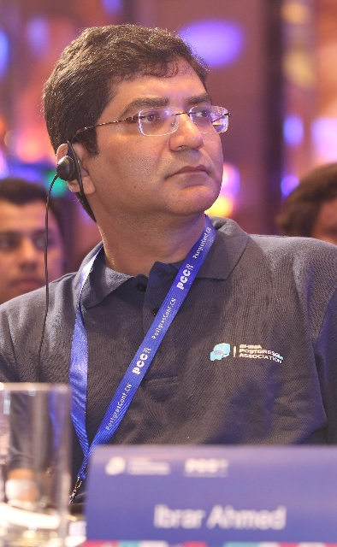
Who am I?
Software Career
Software industries since 1998.
PostgreSQL Career
Working on PostgreSQL Since 2006.
EnterpriseDB (Associate Software Architect core Database Engine) 2006-2009
EnterpriseDB (Software Architect core Database Engine) 2011 - 2016
EnterpriseDB (Senior Software Architect core Database Engine) 2016 – 2018
Percona (Senior Software Architect core Database Engine) 2018 – Present
@ibrar_ahmad
IBRAR AHMED
Principal Engineer
https://www.facebook.com/ibrar.ahmed
Percona LLC
PostgreSQL Books
https://www.linkedin.com/in/ibrarahmed74/
PostgreSQL Developer's Guide
PostgreSQL 9.6 High Performance

Slide 3

Co-Speaker / Coordinator
Naeem has around 2 decades of professional software development experience and has been involved with PostgreSQL for more than a decade now. He was part of EnterpriseDB where he worked on PostgreSQL builds, packaging, regressions, automation and software composition analysis of supported products. Naeem is currently a Software Engineer for PostgreSQL at Percona where he is contributing to the community as well as Percona's PostgreSQL offerings.
Naeem Akhter
Senior Q/A Engineer
https://www.linkedin.com/in/naeem-akhter-372b6239/
Percona LLC

Slide 4
Database Performance
Database Performance
PostgreSQL Architecture
PostgreSQL Performance Tuning
Key Factors about Database Performance
PostgreSQL Modules
Tune your PostgreSQL Box
Database Benchmarking
Linux Kernel Tuning
Benchmark your database
Tune you Linux Box

Slide 5

01
Database Performance

Slide 6


Database Performance
Hardware
Operating System
Software
Choose your hardware wisely
Operating System Selection and Tuning
Software Impact on database performance
Workload
Database
Choose Database according to your workload
Choose your database according your data need

Slide 7
Software
Software Type
Impact of badly written and well-defined software
Queries
Impact of Database Queries on the database
Connectors
Choose your connector wisely

Slide 8
Hardware
Processor
CPU performance and number of processor cores
Memory
Memory requirement for your workload
Disk
Disk speed and size
Network
Network latency

Slide 9
Operating System
Environment
Operating system environment according to your database and application
Compatibility
Operating system compatibility with your database and application
Performance
Operating system performance which suites your database
Support
How good is your support for operating system

Slide 10
Workload
SQL / NOSQL
Is your workload best suited for SQL or NOSQL?
Size of Workload
Size of workload is important for tuning
OLTP / OLAP
Type of workload, is it OLAP or OLTP
Read / Write Intensive
Is your workload Read or Write intensive?

Slide 11
Database

Slide 12
02
PostgreSQL Architecture

Slide 13

PostgreSQL Architecture
Archiver process
Logging Collector
Auto VACUUM
WAL Writter
Bg Writters
Checkpointer
Stat collector
Postmaster
Data Files (table space)
Data Files ($PGDATA)
13007/12831
13007/12833
13007/12832
12832
12832
Postgres
Postgres
Postgres
WAL Files (pg_wal)
000000010000000000000085
000000010000000000000090
00000001000000000000009B
Shared_buffers
WAL Buffers
CLOG buffers
Temp Buffers
Log Files
Buffers

Slide 14
03
PostgreSQL Performance Tuning

Slide 15
Database Performance
Tuning Parameter
PostgreSQL Indexes
Query Analysis
PostgreSQL Tuning Parameters
Impact of index on Database Performance
Analyze your queries for optimal database performance
Partitioning
Monitoring
Partition your database when require
Monitor your database to identify the bottleneck

Slide 16
Software/Environment Requirements
Any host OS (Linux, Windows, MacOS) that supports following virtualisation and automation workflow software.
Vagrant
Vagrant is a tool by HashiCorp for building and managing virtual environment in a single workflow.
Supported on MacOS, Linux and Windows.
A single declarative configuration file (Vagrantfile) to describe OS, Packages and configuration. We will create and edit this file as per out need.
Using Vagrant CLI (command line) and Vagrantfile, we will spawn a VM using Virtualisation provided by VirtualBox.
We will install Vagrant latest version 2.2.x, steps in upcoming slides.
VirtualBox
Oracle VM VirtualBox is a hypervisor for x86 virtualization developed by Oracle Corporation.
An inception of a computer, where you can run sandboxed OS within your computer.
We will use the latest compatible version of VirtualBox 6.1.x to work seamlessly with vagrant.

Slide 17
Virtual Machine ( Virtual Box)
Install VirtualBox 6.1.34
Install Vagrant 2.2.19.
Download the Ubuntu 20.04.x vagrant box for the vagrant cloud.
Create a local directory on your computer to work with.
Create/Edit a new Vagrantfile for spawning a new VM of Ubuntu 20.04.x.
Spawn/Start the VM.
Login (ssh) to spawned VM using CLI.
Install the PostgreSQL version 14.3 in the VM, and start it.
Fiddle with settings of PostgreSQL server, start/stop the server to follow rest of training.

Slide 18
VirtualBox Installation
The latest version is 6.1.34 which we need to install.
Open your web browser and navigate to https://www.virtualbox.org/wiki/Downloads.
Look for heading/caption(VirtualBox 6.1.34 platform packages).
Under the above heading, you will find the links for downloading the VirtualBox software for Windows hosts, OX X hosts and Linux distributions.
Download the appropriate software distribution as per your computer/laptop OS.
Note: In the case of Linux distributions, it will take you to the next page to choose the download package as per your computer’s Linux host flavour.
Run the downloaded installer/package and follow the instruction as you proceed.

Slide 19
Vagrant Installation
The latest version is 2.2.19 which we need to install.
Open your web browser and navigate to https://www.vagrantup.com/downloads.
Look for tabs that are specific to your computer OS: macOS, Windows, Linux, Debian
For macOS: better to download the macOS binary file and install it, if you are not already using brew, takes time set up to brew itself.
For Windows: choose Amd64 (64-bit installer), you are likely to have this architecture.
For Linux: under the Linux, tab chooses the flavour of your OS, and follow the steps.
Note: In the case of Linux distributions, it will take you to the next page to choose the download package as per your computer’s Linux host flavour.
Run the downloaded installer/package and follow the instructions as you proceed.

Slide 20
Download Ubuntu 20.04.x Box
Download the Ubuntu 20.04.x Vagrant box from Vagrant Cloud to your local machine so that it is accessible to Vagrant CLI and VirtualBox.
We will use the ubuntu/focal64 vagrant box from Vagrant Cloud.
Run this command to download: vagrant box add ubuntu/focal64
After a few moments, the output will let you know it's successful.

Slide 21
Create A Working directory
Create a directory where your virutal hosts(s) will live. This will contain all your virtual machines installations and files.
$ mkdir ~/demo
$ cd demo
$ mkdir ubuntu
$ cd ubuntu
$
Note: Your path will be slightly different for Windows, using C:/, but otherwise will be the same idea.

Slide 22
Ubuntu VM Startup
Now we need to initiliaze the Ubuntu 20.04.x VM in directory (~/demo/ubuntu), that was created in last step.
Run command to initialize and create a Vagrantfile: $ vagrant init ubuntu/focal64
Following message will be shown after successfully creating a Vagrantfile in current directory. A `Vagrantfile` has been placed in this directory. You are now ready to `vagrant up` your first virtual environment! Please read the comments in the Vagrantfile as well as documentation on`vagrantup.com` for more information on using Vagrant.
Now we are ready to start up the VM using this command while remaining in same directory: $ vagrant up
This will create the VM, perform the required configuration, download packages and updates to the VM.
After a few minutes, everything is good to go!.

Slide 23
Login to VM
If everything has gone to plan, we are ready to login into our new Ubuntu VM.
We will login into the VM same way as we login to a remote linux machine or VM using ssh, we will do the same with vagrant.
Securely login to VM using command: $ vagrant ssh
You will see following message and have Ubuntu VM command prompt ready to work with: Welcome to Ubuntu 20.04.3 LTS (GNU/Linux 5.4.0-91-generic x86_64) ……………. vagrant@ubuntu-focal:~$
Now we are ready to install the PostgreSQL server in our new Ubuntu VM.

Slide 24
Install PostgreSQL 14 Server
Using Ubuntu VM CLI Perform following commands to install the Postgres 14.3 server:
$ sudo sh -c 'echo "deb http://apt.postgresql.org/pub/repos/apt $(lsb_release -cs)-pgdg main" > /etc/apt/sources.list.d/pgdg.list'
$ cat /etc/apt/sources.list.d/pgdg.list
$ wget --quiet -O - https://www.postgresql.org/media/keys/ACCC4CF8.asc | sudo apt-key add -
$ sudo apt-get update
$ sudo apt-get -y install postgresql-14
If everything goes as planned, now you are ready to use PostgreSQL server 14.3:
Verify installation is successful: $ sudo psql –V psql (PostgreSQL) 14.3 (Ubuntu 14.3-1.pgdg20.04+1)

Slide 25
Install PostgreSQL 14 Server
To edit the postgresql.conf file, use the following command with the file path provided below: $ sudo vim /etc/postgresql/14/main/postgresql.conf To access Postgres server psql command prompt: $ sudo -u postgres psql
To start/stop/restart Postgres server:
$ sudo service postgresql start
$ sudo service postgresql stop
$ sudo service postgresql restart

Slide 26
Tuning Parameters
Memory based configuration parameters
shared_buffers
02
wal_buffers
03
effective_cache_size
1
PostgreSQL Memory buffer
Buffer for WAL
PostgreSQL Cache
04
work_mem
05
maintenance_work_mem
06
Other
Buffer for sorting
Buffer for Maintenance activity
postgresql.conf file contains all the parameters

Slide 27

shared_buffers
PostgreSQL uses its own buffer along with kernel buffered I/O.
PostgreSQL does not change the information on disk directly then how?
Writes the data to shared buffer cache.
The backend process write that these blocks kernel buffer.
postgresql=# SHOW shared_buffers;
shared_buffers
----------------
128MB
(1 row)
The proper size for the POSTGRESQL shared buffer cache is the largest useful size that does not adversely affect other activity.
—Bruce Momjian

Slide 28
wal_buffer
Do you have Transaction? Obviously
WAL – (Write Ahead LOG) Log your transactions
Size of WAL files 16MB with 8K Block size (can be changed at compile time)
PostgreSQL writes WAL into the buffers(wal_buffer ) and then these buffers are flushed to disk.
Bigger value for wal_buffer in case of lot of concurrent connection gives better performance.

Slide 29
effective_cache_size
This used by the optimizer to estimate the size of the kernel's disk buffer cache.
The effective_cache_size provides an estimate of the memory available for disk caching.
It is just a guideline, not the exact allocated memory or cache size.

Slide 30
work_mem
This configuration is used for complex sorting.
It allows PostgreSQL to do larger in-memory sorts.
Each value is per session based, that means if you set that value to 10MB and 10 users issue sort queries then 100MB will be allocated.
In case of merge sort, if x number of tables are involved in the sort then x * work_mem will be used.
It will allocate when required.
Line in EXPLAIN ANALYZE “Sort Method: external merge Disk: 70208kB”

Slide 31

work_mem
postgres=# SET work_mem ='2MB';
postgres=# EXPLAIN ANALYZE SELECT * FROM foo ORDER BY id;
QUERY PLAN
-------------------------------------------------------------------------------------------------------------
Gather Merge (cost=848382.53..1917901.57 rows=9166666 width=9) (actual time=5646.575..12567.495 rows=11000000 loops=1)
-> Sort (cost=847382.51..858840.84 rows=4583333 width=9) (actual time=5568.049..7110.789 rows=3666667 loops=3)
Planning Time: 0.055 ms
Execution Time: 13724.353 ms
postgres=# SET work_mem ='1GB';
postgres=# EXPLAIN ANALYZE SELECT * FROM foo ORDER BY id;
QUERY PLAN
-------------------------------------------------------------------------------------------------------------
Sort (cost=1455965.01..1483465.01 rows=11000000 width=9) (actual time=5346.423..6554.609 rows=11000000 loops=1)
Sort Key: id
Sort Method: quicksort Memory: 916136kB
-> Seq Scan on foo (cost=0.00..169460.00 rows=11000000 width=9) (actual time=0.011..1794.912 rows=11000000 loops=1)
Planning Time: 0.049 ms
Execution Time: 7756.950 ms

Slide 32
maintenance_work_mem
maintenance_work_mem is a memory setting used for maintenance tasks.
The default value is 64MB.
Setting a large value helps in tasks like
VACUUM
RESTORE
CREATE INDEX
ADD FOREIGN KEY
ALTER TABLE.

Slide 33
maintenance_work_mem
CHECKPOINT;
SET maintenance_work_mem='10MB';
SHOW maintenance_work_mem;
maintenance_work_mem
----------------------
10MB
(1 row)
postgres=# CREATE INDEX idx_foo ON foo(id);
Time: 12374.931 ms (00:12.375)
CHECKPOINT;
SET maintenance_work_mem='1GB';
SHOW maintenance_work_mem;
maintenance_work_mem
----------------------
1GB
(1 row)
postgres=# CREATE INDEX idx_foo ON foo(id);
Time: 9550.766 ms (00:09.551)

Slide 34
synchronous_commit
This is used to enforce that commit will wait for WAL to be written on disk before returning a success status to the client.
This is a trade-off between performance and reliability.
Increasing reliability decreases performance and vice versa.
Synchronous commit doesn't introduce the risk of corruption, which is really bad, just some risk of data loss.
https://wiki.postgresql.org/wiki/Tuning_Your_PostgreSQL_Server

Slide 35
Tuning Parameters
I/O based configuration parameters
checkpoint_completion_target
checkpoint_timeout
max_wal_size
01
Time for checkpoint
02
Max WAL size
03
Checkpoint completion target

Slide 36
checkpoint_timeout
PostgreSQL writes changes into WAL. The checkpoint process flushes the data into the data files.
More checkpoints have a negative impact on performance.
Frequent checkpoint reduce the recovery time

Slide 37
checkpoint_completion_target
Specifies the target of checkpoint completion, as a fraction of total time between checkpoints.
This parameter can only be set in the postgresql.conf file or on the server command line

Slide 38
max_wal_size
Maximum size to let the WAL grow during automatic checkpoints.
This is a soft limit; WAL size can exceed max_wal_size under special circumstances.
This parameter can only be set in the postgresql.conf file or on the server command line.

Slide 39
04
PostgreSQL Indexes

Slide 40
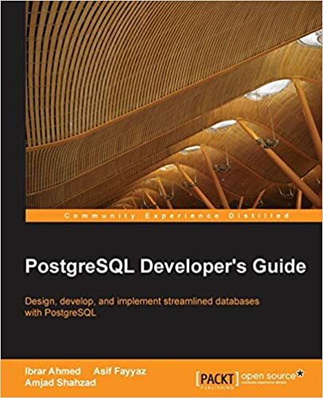
Heap / Index

Slide 41
PostgreSQL Indexes
B-Tree
Hash
Brin
PostgreSQL default index Based on B-Tree
PostgreSQL Index Method Based on Hasing
Block Range Index
GIST
GIN
Generalized Search Tree
Generalized Inverted Index

Slide 42
Sequential Scan
SELECT * FROM admin WHERE dt < '2021/04/01';
id | name | dt
-----+-------------+------------
3 | James | 2020-01-01
1 | Alex Johns | 2020-01-02
7 | Bob William | 2020-01-04
8 | Charli | 2020-01-01
6 | David | 2020-08-02
9 | Benjamin | 1990-01-02
SELECT ctid, * FROM admin WHERE id = 8;
ctid | id | name
-------+----+------
(1,0) | 16 | Charli
(1 rows)
pd_lsn
pd_checksum
pd_flags
pd_lower
pd_upper
pd_lsn
pd_checksum
pd_flags
pd_lower
pd_upper
pd_special
pd_pagesize_version
pd_prune_xid
1
2
3
pd_special
pd_pagesize_version
pd_prune_xid
1
2
3
Block 0
Line pointers
Line pointers
Block 1
Tuple 2
Tuple 2
7
Bob William
01/04/2020
1
Benjamin
01/02/1990
1
Alex John
01/02/2020
3
James
01/01/2020
8
Charli
01/01/2020
6
David
01/08/2020
Page size 8192 Bytes
Page size 8192 Bytes

Slide 43
B-Tree Index
SELECT id, name FROM admin WHERE id = 8;
id | name
-----+------
8 | Charli
(1 rows)
9
36
69
9
16
32
36
53
58
69
74
100
8
9
16
19
32
347
36
39
53
54
58
60
69
70
74
75
100
105
(1,1)
0
(1,2)
(1,3)
(1,2)
(1,8)
(2,1)
(2,2)
(2,8)
(3,1)
(3,2)
(4,1)
(4,3)
(4,7)
(4,8)
(5,1)
(5,2)
(7,2)
ctid
pd_lsn
pd_checksum
pd_flags
pd_lower
pd_upper
pd_lsn
pd_checksum
pd_flags
pd_lower
pd_upper
pd_special
pd_pagesize_version
pd_prune_xid
1
2
3
pd_special
pd_pagesize_version
pd_prune_xid
1
2
3
Block 0
Line pointers
Line pointers
Block 1
Tuple 2
Tuple 2
7
Bob William
01/04/2020
1
Benjamin
01/02/1990
1
Alex John
01/02/2020
3
James
01/01/2020
8
Charli
01/01/2020
6
David
01/08/2020
Page size 8192 Bytes
Page size 8192 Bytes

Slide 44
Hash Index
SELECT id, name FROM admin WHERE name LIKE ‘Alex Johns’;
id | name
-----+------
16 | Alex Johns
(1 rows)
Alex Johns
0000
0,0
James
0010
0,1
Bob William
Fh(x)
0011
0,2
Charli
0100
1,0
CTID
David
0101
1,1
Benjamin
0111
1,2
pd_lsn
pd_checksum
pd_flags
pd_lower
pd_upper
pd_lsn
pd_checksum
pd_flags
pd_lower
pd_upper
pd_special
pd_pagesize_version
pd_prune_xid
1
2
3
pd_special
pd_pagesize_version
pd_prune_xid
1
2
3
Block 0
Line pointers
Line pointers
Block 1
Tuple 2
Tuple 2
7
Bob William
01/04/2020
1
Benjamin
01/02/1990
1
Alex John
01/02/2020
3
James
01/01/2020
8
Charli
01/01/2020
6
David
01/08/2020
Page size 8192 Bytes
Page size 8192 Bytes

Slide 45
05
Linux Tuning for PostgreSQL

Slide 46
Linux Tuning
Memory Architecture
Huge Pages
Transparent Huge Pages
How to create indexes in PostgreSQL
Linux Huge pages
Linux Transparent Huge Pages
Tuning Parameters
Monitoring
Tune your Linux Box
Monitor your Linux OS

Slide 47
Input Output Handling
Direct IO, Buffered IO and Double buffering
PostgreSQL believes that the Operating system (Kernel) knows much better about storage and IO scheduling.
PostgreSQL has its own buffering; and also needs the pages cache. Double Buffering
It Increase the use of memory.
And different kernel and setting behave differently.

Slide 48
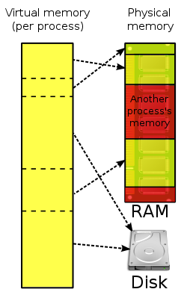
Virtual Memory
Every process is given the impression that it is working with large, contiguous sections of memory
Each process runs in its own dedicated address space
Pages Table are used to translate the virtual addresses seen by the application into Physical Address
https://en.wikipedia.org/wiki/Virtual_memory
https://en.wikipedia.org/wiki/Page_table

Slide 49
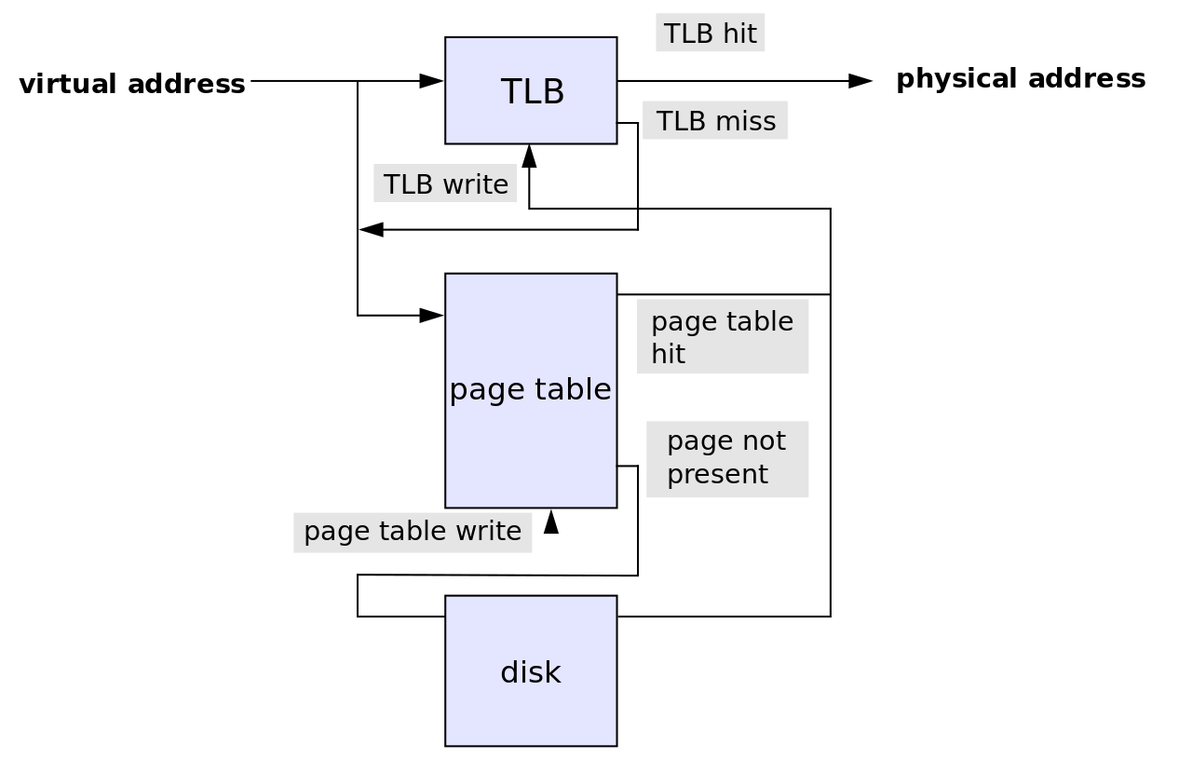
Translation Lookaside Buffer (TLB)
Translation Lookaside Buffer is a memory cache
It reduce the time to access a user memory location
If a match is found the physical address of the page is returned → TLB hit
If match not found scan the page table (walk)
looking for the address mapping (entry) → TLB miss
Small page size bigger TLB size → expensive

Slide 50
Memory Pages
PostgreSQL uses its own buffer along with kernel buffered I/O.
PostgreSQL does not change the information on disk directly then how?
Writes the data to shared buffer cache.
The backend process write that these blocks kernel buffer.

Slide 51
Linux Page sizes
Linux Page size is 4K
Many modern processors support other page sizes
If we consider a server with 256G of RAM:
4K | 67108864
2M | 131072
1G | 256
large/huge pages
Notes:
The address translation logic is also known as page table walking
The page table walk is expensive because it may require multiple memory accesses
Using large pages to improve the effectiveness of the TLB
by increasing the page size we'll have less pages to map

Slide 52
Classic Huge Pages
# cat /proc/meminfo
MemTotal: 264041660 kB
...
Hugepagesize: 2048 kB
DirectMap4k: 128116 kB
DirectMap2M: 3956736 kB
DirectMap1G: 266338304 kB
sysctl -w vm.nr_hugepages=256
Notes:
"Default" huge page size
DirectMap here is related to TLB use, I'm unsure if accurate though

Slide 53
Tuning Parameters
03
05
Classic Huge Pages
Tranparent Huge Pages
swappines
1
02
overcommit_memory & overcommit_ratio
04
dirty_background_ratio & dirty_background_bytes
06
vm.dirty_ratio & vm.dirty_bytes

Slide 54
Classic Huge Pages
# vi /etc/default/grub
GRUB_CMDLINE_LINUX_DEFAULT="hugepagesz=1GB default_hugepagesz=1G”
# update-grub
Generating grub configuration file ...
Found linux image: /boot/vmlinuz-4.4.0-75-generic
Found initrd image: /boot/initrd.img-4.4.0-75-generic
Found memtest86+ image: /memtest86+.elf
Found memtest86+ image: /memtest86+.bin
Done
# shutdown -r now
Notes:
huge page size can only be changed at boot time

Slide 55
Classic Huge Pages
# vim /etc/postgresql/10/main/postgresql.conf
huge_pages=ON # default is try
# service postgresql restart

Slide 56
Transparent Huge pages
The kernel works in the background (khugepaged) trying to:
"create" huge pages.
Find enough contiguous blocks of memory
Convert them into a huge page
Transparently allocate them to processes when there is a "fit"
Notes:
Transparent Hugepage Support is an alternative means of using huge pages for the backing of virtual memory with huge pages that supports the automatic promotion and demotion of page sizes

Slide 57
Disabling Transparent Huge pages
# cat /proc/meminfo | grep AnonHuge
AnonHugePages: 2048 kB
# ps aux | grep huge
root 42 0.0 0.0 0 0 ? SN Jan17 0:00 [khugepaged]
To disable it:
at runtime:
# echo never > /sys/kernel/mm/transparent_hugepage/enabled
# echo never > /sys/kernel/mm/transparent_hugepage/defrag
at boot time:
GRUB_CMDLINE_LINUX_DEFAULT="(...) transparent_hugepage=never"

Slide 58
vm.swappines
This is another kernel parameter that can affect the performance of the database.
Used to control the swappiness (swapping pages to swap memory into RAM) behavior on a Linux system.
The parameter can take anything from “0” to “100”.
The default value is 60.
Higher value means more aggressively swap.

Slide 59
vm.overcommit_memory and vm.overcommit_ratio
Applications acquire memory and free that memory when it is no longer needed.
But in some cases, an application acquires too much memory and does not release it. This can invoke the OOM killer.
This is used to control the memory over-commit.
It has three options
Heuristic overcommit, Do it intelligently (default); based kernel heuristics
Allow overcommit anyway
Don’t over commit beyond the overcommit ratio.

Slide 60
vm.dirty_background_ratio and vm.dirty_background_bytes
The vm.dirty_background_ratio is the percentage of memory filled with dirty pages that need to be flushed to disk.
Flushing is done in the background.
The value of this parameter ranges from 0 to 100;

Slide 61
vm.dirty_ratio / vm.dirty_bytes
The vm.dirty_background_ratio is the percentage of memory filled with dirty pages that need to be flushed to disk.
Flushing is done in the foreground.
The value of this parameter ranges from 0 to 100;

Slide 62
Questions

Slide 63
Thank you!

Slide 64


